Slide 1

CSE 470/598 Shading
Ross Maciejewski
rmacieje@asu.edu

Slide 2
Disclaimer
These slides can only be used as study material for the class 470 at ASU
The slides cannot be distributed or used for another purpose

Slide 3
Objectives
Learn to shade objects so their images appear three-dimensional
Introduce the types of light-material interactions
Build a simple reflection model---the Phong model---that can be used with real-time graphics hardware

Slide 4
Why we need shading
Suppose we build a model of a sphere using many polygons and color it with glColor. We get something like
But we want

Slide 5
Components of Light and Shade
What are the basic components of light and shade?
Why does a sphere look like this?

Slide 6
Shading
Why does the image of a real sphere look like this?
Light-material interactions cause each point to have a different color or shade
Need to consider
Light sources
Material properties
Location of viewer
Surface orientation

Slide 7
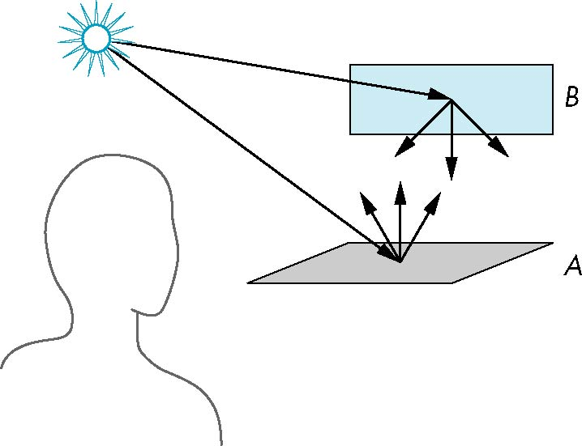
Scattering
Light strikes A
Some scattered
Some absorbed
Some of scattered light strikes B
Some scattered
Some absorbed
Some of this scattered light strikes A and so on

Slide 8
Rendering Equation
Scattering and absorption of light can be described by the rendering equation
Cannot be solved in general
Ray tracing is a special case for perfectly reflecting surfaces
Rendering equation is global and includes
Shadows
Multiple scattering from object to object

Slide 9
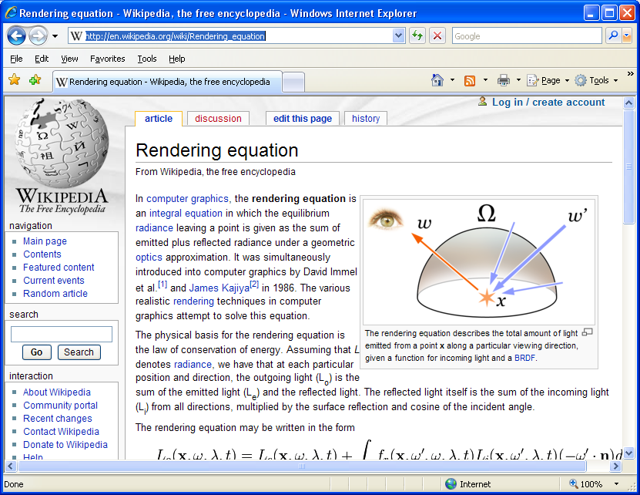
Rendering Equation (2)

Slide 10
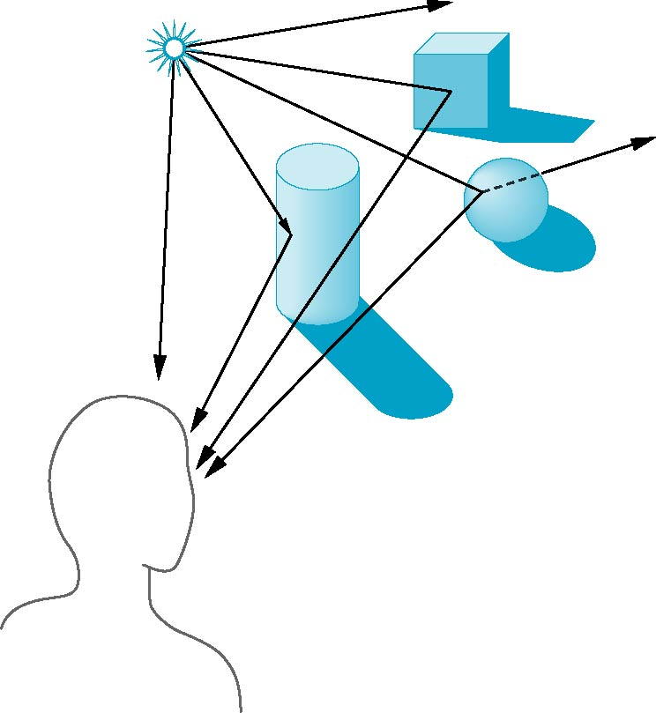
Global Effects
shadow
multiple reflection
translucent surface

Slide 11
Local vs Global Rendering
Correct shading requires a global calculation involving all objects and light sources
Incompatible with pipeline model which shades each polygon independently (local rendering)
In computer graphics, especially real-time, we are happy if things “look right”
We can fake it
Approximating global effects

Slide 12
Light-Material Interaction
Light that strikes an object is partially absorbed and partially scattered (reflected)
Amount reflected determines the color and brightness of the object
A surface appears red under white light because the red component of the light is reflected and the rest is absorbed
Reflected light is scattered in a manner that depends on the smoothness and orientation of the surface

Slide 13
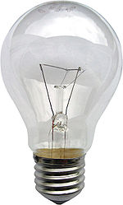
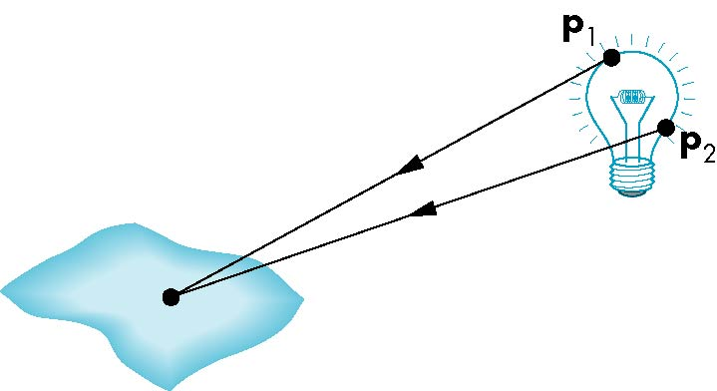
Light Sources
General light sources are difficult to work with because we must integrate light coming from all points on the source

Slide 14
Simple Light Sources
Point source
Model with position and color
Distant source = infinite distance away (parallel)
Spotlight
Restrict light from ideal point source
Ambient light
Same amount of light everywhere in scene
Can model contribution of many sources and reflecting surfaces

Slide 15
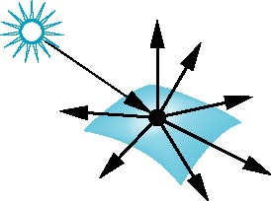
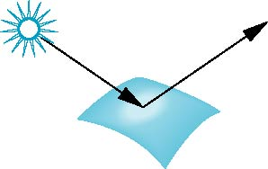
Surface Types
The smoother a surface, the more reflected light is concentrated in the direction a perfect mirror would reflected the light
A very rough surface scatters light in all directions
smooth surface
rough surface

Slide 16
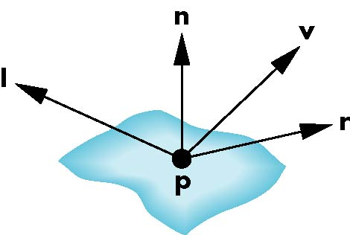
Phong Model
A simple model that can be computed rapidly
Has three components
Diffuse
Specular
Ambient
Uses four vectors
To source
To viewer
Normal
Perfect reflector

Slide 17
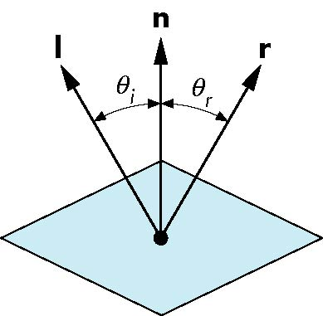
Ideal Reflector
Normal is determined by local orientation
Angle of incidence = angle of relection
The three vectors must be coplanar
r = 2 (l · n ) n - l

Slide 18
Lambertian Surface
Perfectly diffuse reflector
Light scattered equally in all directions
Amount of light reflected is proportional to the vertical component of incoming light
reflected light ~cos θ_{i}
cos θ_{i} = l · n if vectors normalized
There are also three coefficients, k_{r}, k_{b}, k_{g} that show how much of each color component is reflected

Slide 19

Specular Surfaces
Most surfaces are neither ideal diffusers nor perfectly specular (ideal reflectors)
Smooth surfaces show specular highlights due to incoming light being reflected in directions concentrated close to the direction of a perfect reflection
specular
highlight

Slide 20
Modeling Specular Relections
Phong proposed using a term that dropped off as the angle between the viewer and the ideal reflection increased
I_{r} ~ k_{s} I cos^{α}φ
φ
reflected
intensity
shininess coef
incoming intensity
absorption coef

Slide 21
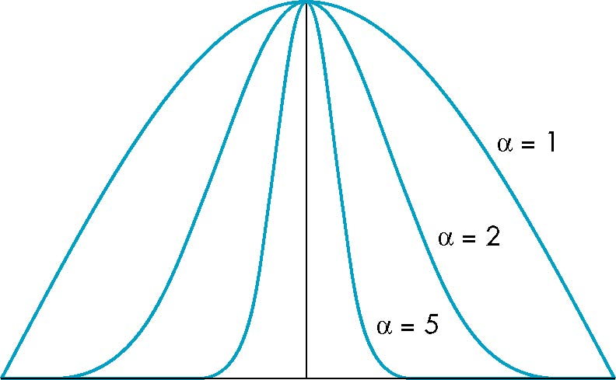
The Shininess Coefficient
Values of α between 100 and 200 correspond to metals
Values between 5 and 10 give surface that look like plastic
cos^{α} φ
-90
φ
90

Slide 22
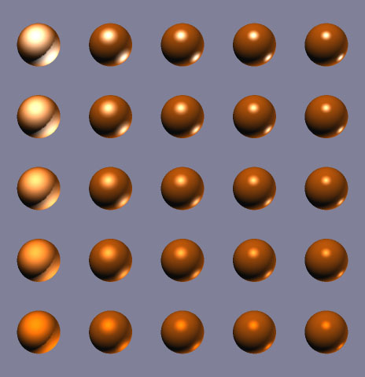
Shininess: Example
specular = white
specular = diffuse
5
25
45
65
85

Slide 23
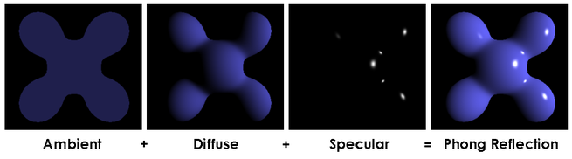
Phong Shading

Slide 24
Recap
Phong shading
Scattering
Reflection
Rendering equation
Global rendering
Local rendering
Point source
Spotlight
Parallel/directional light source
Lambertian surface
Shininess coefficient
Perfect diffuser
Ideal reflector

Slide 25
Objectives
Continue discussion of shading
Introduce modified Phong model
Consider computation of required vectors
Look at light and shade in computer games

Slide 26
Recap
Need light to achieve realism
Correct light and shading requires solving rendering equation
Cannot be solved for general case
Local rendering: reasonable result
Fake it!
Different light sources
Point, directional, spot
Phong model
4 vectors, 3 light components

Slide 27
Light Equation
Last lecture: background information
Time to discuss how OpenGL computes light!
Light intensity I computed for each color component (R, G, B)
3D-vector (but not for x, y, z)
I = I_{D} + I_{S} + I_{A}

Slide 28
Ambient Light
Ambient light is the result of multiple interactions between (large) light sources and the objects in the environment
Amount and color depend on both the color of the light(s) and the material properties of the object
Add k_{a} I_{a} to diffuse and specular terms
reflection coef
intensity of ambient light

Slide 29
Distance Terms
The light from a point source that reaches a surface is inversely proportional to the square of the distance between them
We can add a factor of the
form 1/(ad + bd +cd²) to
the diffuse and specular
terms
The constant and linear terms soften the effect of the point source

Slide 30
Light Sources
Phong Model: we add the results from each light source
Each light source has separate diffuse, specular, and ambient terms to allow for maximum flexibility even though this form does not have a physical justification
Separate red, green and blue components
Hence, 9 coefficients for each point source
I_{dr}, I_{dg}, I_{db}, I_{sr}, I_{sg}, I_{sb}, I_{ar}, I_{ag}, I_{ab}

Slide 31
Material Properties
Material properties match light source properties
Nine absorbtion coefficients
k_{dr}, k_{dg}, k_{db}, k_{sr}, k_{sg}, k_{sb}, k_{ar}, k_{ag}, k_{ab}
Shininess coefficient α

Slide 32
Adding up the Components
For each light source and each color component, the Phong model can be written (without the distance terms) as
I =k_{d} I_{d} l · n + k_{s} I_{s} (v · r )^{α} + k_{a} I_{a}
For each color component
we add contributions from
all sources

Slide 33
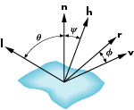
Modified Phong Model
Specular term in the Phong model is problematic because it requires the calculation of a new reflection vector and view vector for each vertex
Blinn suggested an approximation using the halfway vector that is more efficient
Blinn light model
See textbook for details

Slide 34
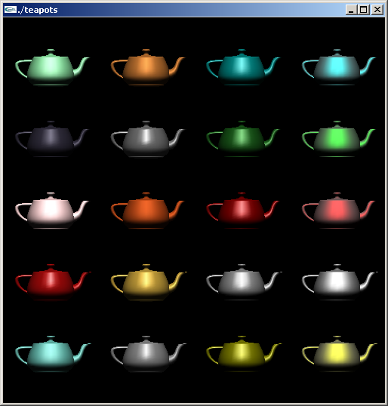
Example
Only differences in
these teapots are
the parameters
in the modified
Phong model

Slide 35
Computation of Vectors
l and v are specified by the application
Can computer r from l and n
Problem is determining n
For simple surfaces is can be determined but how we determine n differs depending on underlying representation of surface
OpenGL leaves determination of normal to application
Exception for GLU quadrics and Bezier surfaces (Chapter 11)

Slide 36
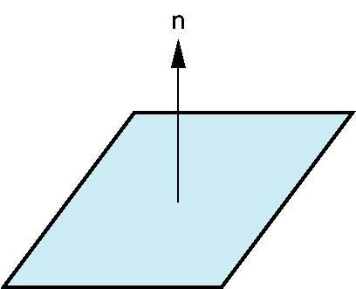
Plane Normals
Equation of plane: ax+by+cz+d = 0
From Chapter 4 we know that plane is determined by three points p₀, p₂, p₃ or normal n and p₀
Normal can be obtained by
n = (p₂-p₀) × (p₁-p₀)

Slide 37
Triangle Normals and Flat Shading
Flat shading: use one light value per face
Compute light equation once per triangle
Use normal of whole face
Remember: Light value determined by dot product: I =k_{d} I_{d} l · n
Use one single color for whole face

Slide 38
Vertex Normals
Smooth (Gouraud) shading allows for different color per vertex
Color is interpolated across triangle surface
Need to compute light per vertex (not face)
Vertices don’t have normals…
…but we can fake this
Compute average normal of all triangles each vertex belongs to

Slide 39
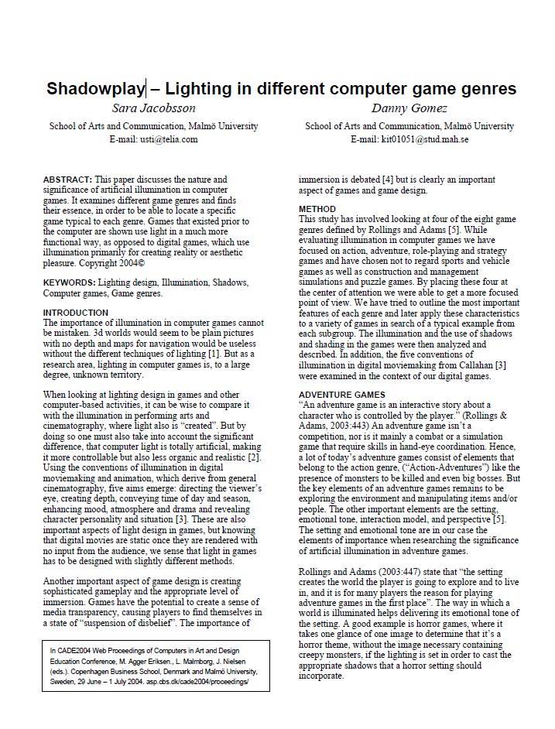
Light and Shading in Games
Graphics major component of modern computer games
Just like movies: light and shade important for setting tone, mood, and atmosphere
[Jacobsson and Gomez 2004]

Slide 40
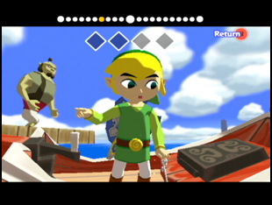
Adventure Games
Interactive story about a player-controlled character
Setting and emotional tone important
Lighting often used to direct attention to significant items
Example: Legend of Zelda: The Wind Waker

Slide 41
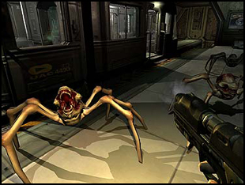
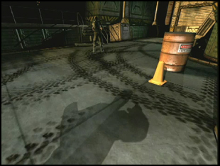
Action Games
Kill opponents, don’t die
Illumination to help pump up adrenaline
Primitive hunting instinct
Practical use: hide monsters
Especially important for horror-style games
Example: Doom 3

Slide 42
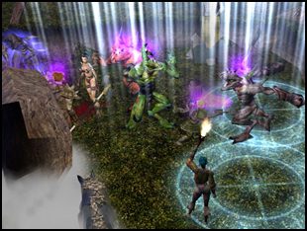
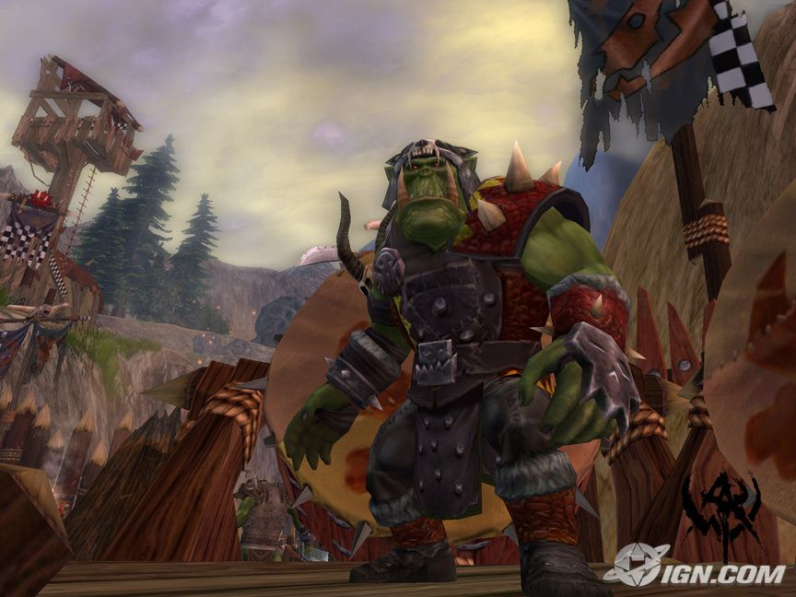
Role-Playing Games
Follow a developable character in a story
Immersion important
Large spectra of colors to convey supernatural mood
Colors to convey spells
Examples: Neverwinter Nights and Warhammer Online

Slide 43
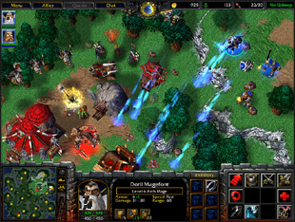
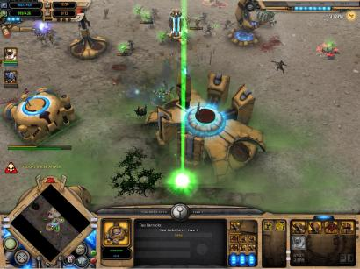
Strategy Games
Direct an army to defeat opponent’s army
Need organized design
Some realism aspects, but also usability
Fog of War – convey explored areas of map, and areas not seen
Examples: Warcraft 3 and Dawn of War

Slide 44
Light in Games: Conclusion
Light and shade can be used for many things
Realism
Setting mood
Directing attention
Communicating information

Slide 45
Recap
Light sources
Point, directional, spot
Phong model
Four vectors, three components
I = I_{D} + I_{S} + I_{A}
Vectors
Vectors v and l given by application
Can compute r given normal n
Need to compute normals (OpenGL will not help)

Slide 46
Steps in OpenGL shading
Enable shading and select model
Specify normals
Specify material properties
Specify lights

Slide 47
Normals
In OpenGL the normal vector is part of the state
Set by glNormal*()
glNormal3f(x, y, z);
glNormal3fv(p);
Usually we want to set the normal to have unit length so cosine calculations are correct
Length can be affected by transformations
Note that scaling does not preserved length
glEnable(GL_NORMALIZE) allows for autonormalization at a performance penalty

Slide 48
Normal for Triangle
n
plane n ·(p - p₀ ) = 0
p₂
n = (p₂ - p₀ ) ×(p₁ - p₀ )
p
p₁
normalize n ← n/ |n|
p₀
Note that right-hand rule determines outward face

Slide 49
Enabling Shading
Shading calculations are enabled by
glEnable(GL_LIGHTING)
Once lighting is enabled, glColor() ignored
(Can still use GL_COLOR_MATERIAL…)
Must enable each light source individually
glEnable(GL_LIGHTi) i=0,1…..
Can choose light model parameters
glLightModeli(parameter, GL_TRUE)
GL_LIGHT_MODEL_LOCAL_VIEWER do not use simplifying distant viewer assumption in calculation
GL_LIGHT_MODEL_TWO_SIDED shades both sides of polygons independently

Slide 50
Defining a Point Light Source
For each light source, we can set an RGBA for the diffuse, specular, and ambient components, and for the position
GL float diffuse0[]={1.0, 0.0, 0.0, 1.0};
GL float ambient0[]={1.0, 0.0, 0.0, 1.0};
GL float specular0[]={1.0, 0.0, 0.0, 1.0};
Glfloat light0_pos[]={1.0, 2.0, 3,0, 1.0};
glEnable(GL_LIGHTING);
glEnable(GL_LIGHT0);
glLightv(GL_LIGHT0, GL_POSITION, light0_pos);
glLightv(GL_LIGHT0, GL_AMBIENT, ambient0);
glLightv(GL_LIGHT0, GL_DIFFUSE, diffuse0);
glLightv(GL_LIGHT0, GL_SPECULAR, specular0);

Slide 51
Distance and Direction
Source colors are specified in RGBA
Position is given in homogeneous coordinates
If w =1.0, we are specifying a finite location
If w =0.0, we are specifying a parallel source with the given direction vector
Coefficients in the distance terms are by default a=1.0 (constant terms), b=c=0.0 (linear and quadratic terms). Change by
a= 0.80;
glLightf(GL_LIGHT0, GLCONSTANT_ATTENUATION, a);

Slide 52
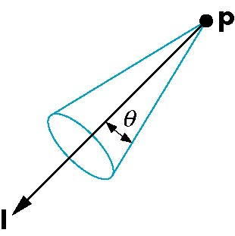
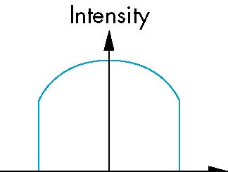
Spotlights
Use glLightv to set
Direction GL_SPOT_DIRECTION
Cutoff GL_SPOT_CUTOFF
Attenuation GL_SPOT_EXPONENT
Proportional to cos^{α}φ
−θ
φ
θ

Slide 53
Global Ambient Light
Ambient light depends on color of light sources
A red light in a white room will cause a red ambient term that disappears when the light is turned off
OpenGL also allows a global ambient term that is often helpful for testing
glLightModelfv(GL_LIGHT_MODEL_AMBIENT, global_ambient)

Slide 54
Moving Light Sources
Light sources are geometric objects whose positions or directions are affected by the model-view matrix
Depending on where we place the position (direction) setting function, we can
Move the light source(s) with the object(s)
Fix the object(s) and move the light source(s)
Fix the light source(s) and move the object(s)
Move the light source(s) and object(s) independently

Slide 55
Material Properties
Material properties are also part of the OpenGL state and match the terms in the modified Phong model
Set by glMaterialv()
GLfloat ambient[] = {0.2, 0.2, 0.2, 1.0};
GLfloat diffuse[] = {1.0, 0.8, 0.0, 1.0};
GLfloat specular[] = {1.0, 1.0, 1.0, 1.0};
GLfloat shine = 100.0
glMaterialf(GL_FRONT, GL_AMBIENT, ambient);
glMaterialf(GL_FRONT, GL_DIFFUSE, diffuse);
glMaterialf(GL_FRONT, GL_SPECULAR, specular);
glMaterialf(GL_FRONT, GL_SHININESS, shine);

Slide 56
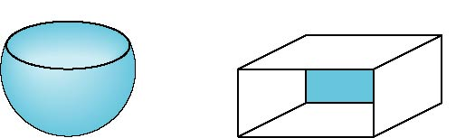

Front and Back Faces
The default is shade only front faces which works correctly for convex objects
If we set two sided lighting, OpenGL will shade both sides of a surface
Each side can have its own properties which are set by using GL_FRONT, GL_BACK, or GL_FRONT_AND_BACK in glMaterialf
back faces not visible
back faces visible

Slide 57
Emissive Term
We can simulate a light source in OpenGL by giving a material an emissive component
This component is unaffected by any sources or transformations
GLfloat emission[] = 0.0, 0.3, 0.3, 1.0);
glMaterialf(GL_FRONT, GL_EMISSION, emission);

Slide 58
Transparency
Material properties are specified as RGBA values
The A value can be used to make the surface translucent
The default is that all surfaces are opaque regardless of A
Later we will enable blending and use this feature

Slide 59
Efficiency
Because material properties are part of the state, if we change materials for many surfaces, we can affect performance
We can make the code cleaner by defining a material structure and setting all materials during initialization
We can then select a material by a pointer
typedef struct materialStruct {
GLfloat ambient[4];
GLfloat diffuse[4];
GLfloat specular[4];
GLfloat shininess;
} MaterialStruct;

Slide 60
Polygonal Shading
Shading calculations are done for each vertex
Vertex colors become vertex shades
By default, vertex shades are interpolated across the polygon
glShadeModel(GL_SMOOTH);
If we use glShadeModel(GL_FLAT); the color at the first vertex will determine the shade of the whole polygon

Slide 61
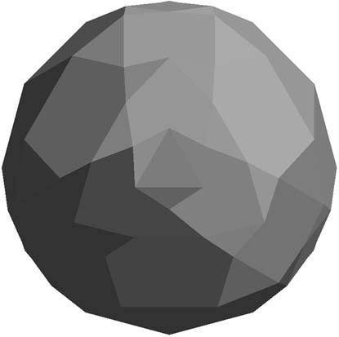
Polygon Normals
Polygons have a single normal
Shades at the vertices as computed by the Phong model can be almost same
Identical for a distant viewer (default) or if there is no specular component
Consider model of sphere
Want different normals at each vertex even though this concept is not quite correct mathematically

Slide 62
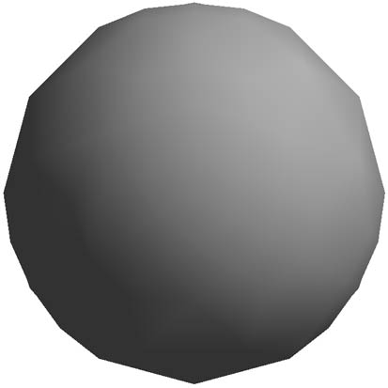
Smooth Shading
We can set a new normal at each vertex
Easy for sphere model
If centered at origin n = p
Now smooth shading works
Note silhouette edge

Slide 63
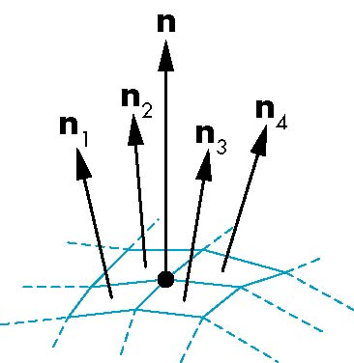
Mesh Shading
The previous example is not general because we knew the normal at each vertex analytically
For polygonal models, Gouraud proposed we use the average of the normals around a mesh vertex
n = (n₁+n₂+n₃+n₄)/ |n₁+n₂+n₃+n₄|

Slide 64
Gouraud and Phong Shading
Gouraud Shading
Find average normal at each vertex (vertex normals)
Apply modified Phong model at each vertex
Interpolate vertex shades across each polygon
Phong shading
Find vertex normals
Interpolate vertex normals across edges
Interpolate edge normals across polygon
Apply modified Phong model at each fragment

Slide 65
Comparison
If the polygon mesh approximates surfaces with a high curvatures, Phong shading may look smooth while Gouraud shading may show edges
Phong shading requires much more work than Gouraud shading
Until recently not available in real-time systems
Now can be done using fragment shaders (see Chapter 9)
Both need data structures to represent meshes so we can obtain vertex normals

